Slide 1


Lecture 26
Produced by Dr. Worldwide
Welcome to the 305
~
~

Slide 2


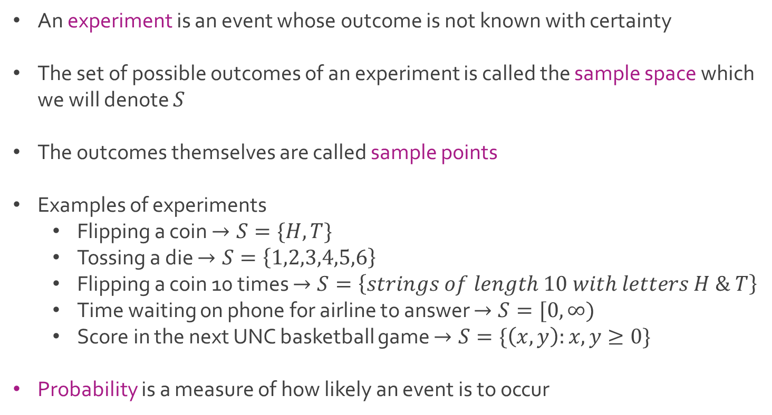
Probabilistic Models
An experiment is an event whose outcome is not known with certainty
The set of possible outcomes of an experiment is called the sample space which we will denote $S$
The outcomes themselves are called sample points
Examples of experiments
Flipping a coin $→S=\{H,T\}$
Tossing a die $→S=\left\{1,2,3,4,5,6\right\}$
Flipping a coin 10 times $→S=\left\{strings of length 10 with letters H \& T\right\}$
Time waiting on phone for airline to answer $→S=[0,∞)$
Score in the next UNC basketball game $→S=\{\left(x,y\right):x,y≥0\}$
Probability is a measure of how likely an event is to occur

Slide 3
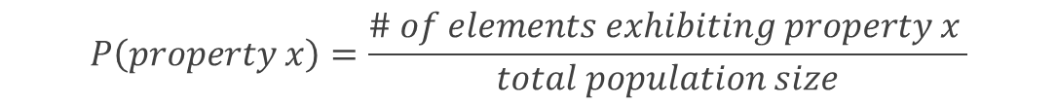
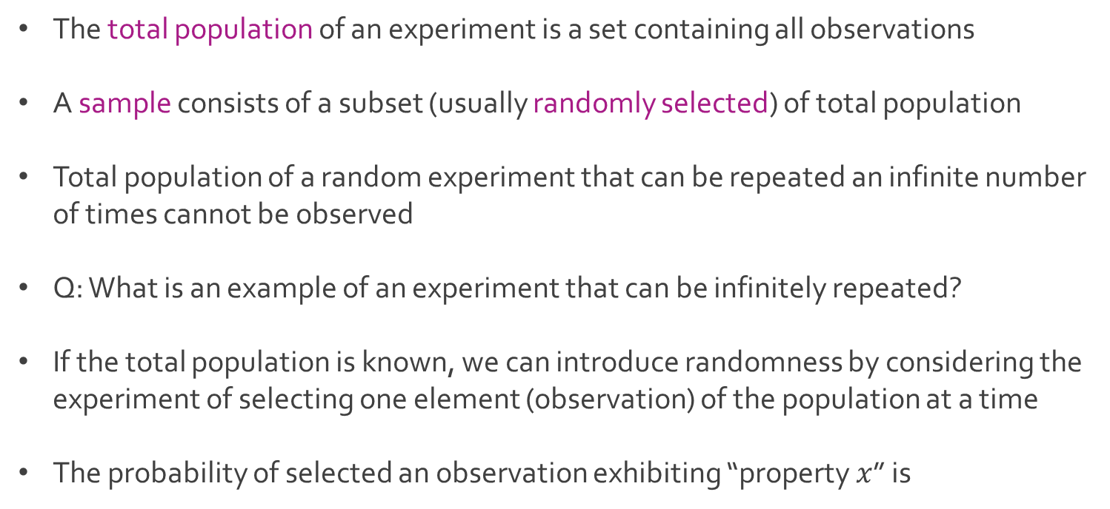
Population vs. Samples
The total population of an experiment is a set containing all observations
A sample consists of a subset (usually randomly selected) of total population
Total population of a random experiment that can be repeated an infinite number of times cannot be observed
Q: What is an example of an experiment that can be infinitely repeated?
If the total population is known, we can introduce randomness by considering the experiment of selecting one element (observation) of the population at a time
The probability of selected an observation exhibiting “property $x$” is
$$P\left(property x\right)=\frac{\# of elements exhibiting property x }{total population size}$$

Slide 4
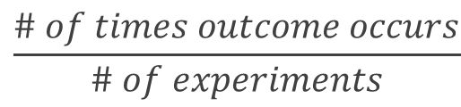
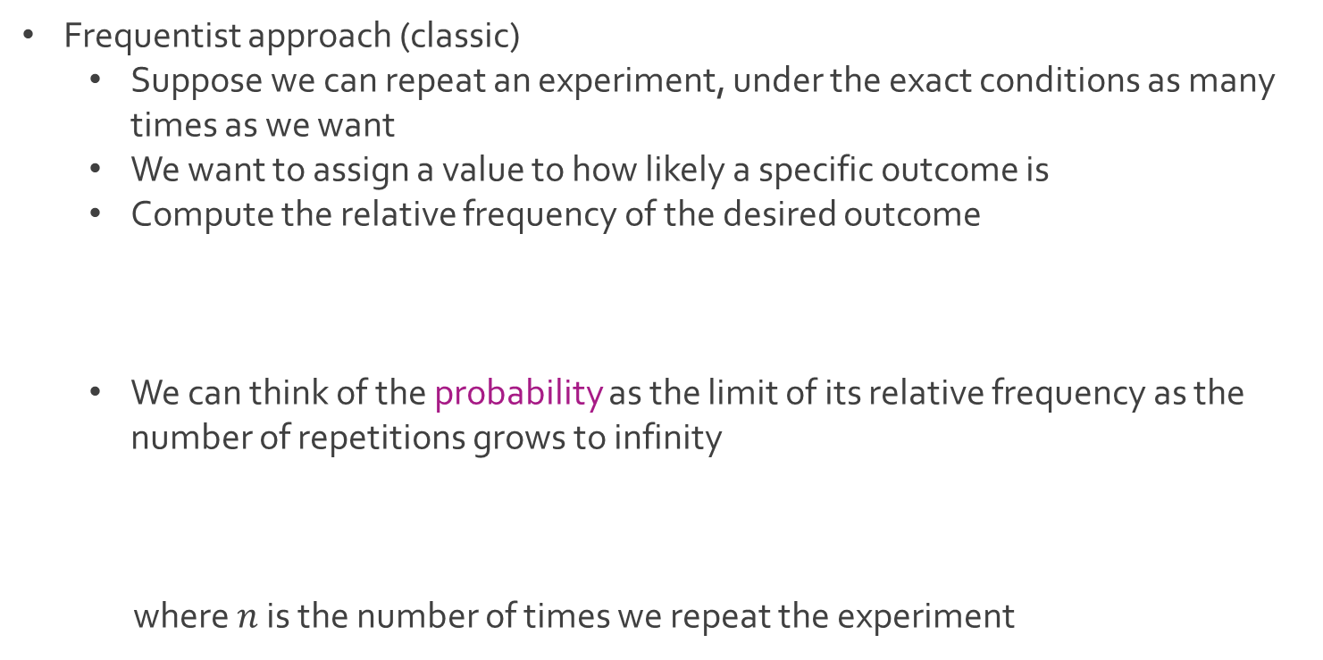
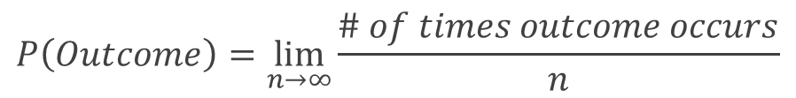
Interpretations of Probability
Frequentist approach (classic)
Suppose we can repeat an experiment, under the exact conditions as many times as we want
We want to assign a value to how likely a specific outcome is
Compute the relative frequency of the desired outcome
We can think of the probability as the limit of its relative frequency as the number of repetitions grows to infinity
where $n$ is the number of times we repeat the experiment
$$\frac{\# of times outcome occurs}{\# of experiments}$$
$$P\left(Outcome\right)=\lim_{n→∞}{\frac{\# of times outcome occurs}{n}}$$

Slide 5
Interpretations of Probability
Bayesian approach
Define probability as the degree of belief rather than the long-run frequency
Degree of belief is based off prior probability (subjective probability) and the relative frequency from observed data
Posterior probability is the updated belief on the probability of an event happening given the prior and data observed
Difference between frequentist and Bayesian approach
Consider the experiment where we flip a coin
We want to find the probability of heads
Frequentist concludes probability is 0.5 under the belief that the relative frequency would get closer to 50% the more the coin is flipped
There is an assumption that out of the two outcomes both are equally likely
Bayesian would take the 50% as a prior belief with a lot of uncertainty until data has been gathered to back up the claim

Slide 6
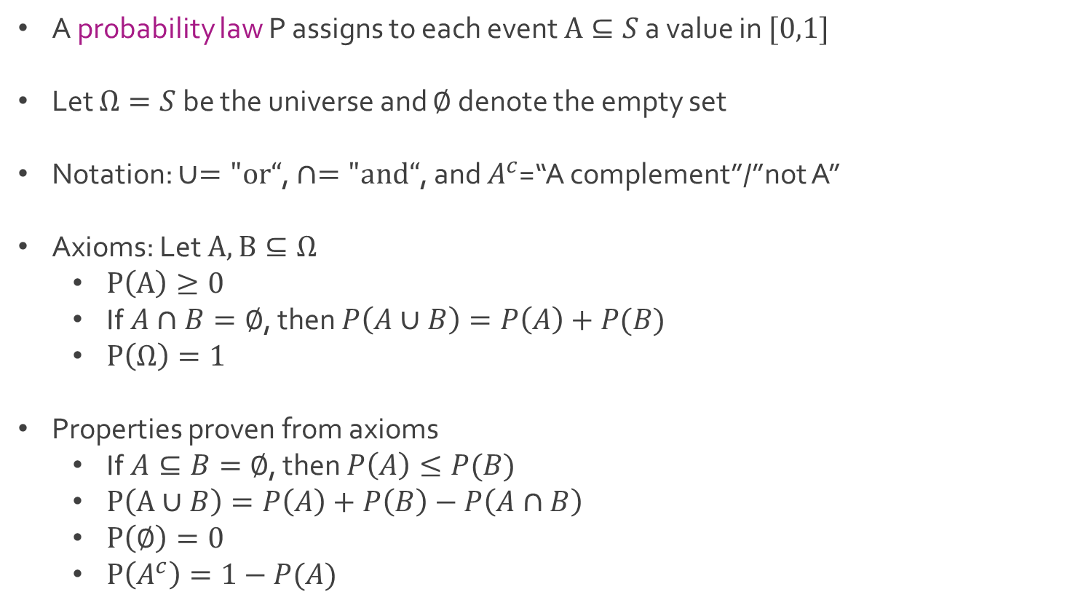
Probability Laws
A probability law P assigns to each event $A⊆S$ a value in $[0,1]$
Let $Ω=S$ be the universe and $∅$ denote the empty set
Notation: $∪="or“$, $∩="and“$, and $A^{c}$=“A complement”/”not A”
Axioms: Let $A,B⊆Ω$
$P\left(A\right)≥0$
If $A∩B=∅$, then $P\left(A∪B\right)=P\left(A\right)+P(B)$
$P\left(Ω\right)=1$
Properties proven from axioms
If $A⊆B=∅$, then $P\left(A\right)≤P(B)$
$P\left(A∪B\right)=P\left(A\right)+P\left(B\right)−P\left(A∩B\right)$
$P\left(∅\right)=0$
$P\left(A^{c}\right)=1−P(A)$

Slide 7
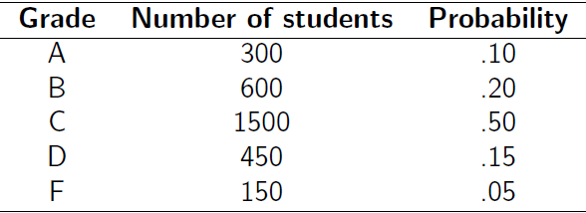
Ex: Letter Grades in School
School collected records of its 3,000 students
Students in the science class have the following grade distribution (probability law)
Experiment = choose at random one of the 3000 students
Q: What is the probability the student’s grade in the science class is an A?
Q: What is the probability the student’s grade is C or higher?
$$P\left(A∪B∪C\right)=P\left(A\right)+P\left(B\right)+P\left(C\right)=0.1+0.2+0.5=0.8=1−P(D∪F)$$

Slide 8
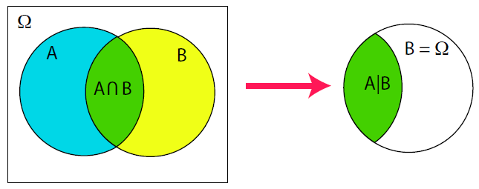
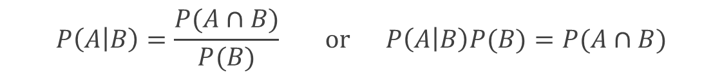
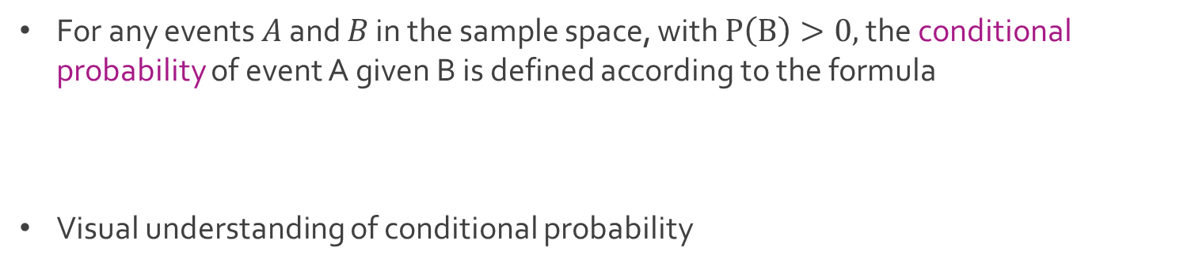
Conditional Probability
For any events $A$ and $B$ in the sample space, with $P\left(B\right)>0,$ the conditional probability of event A given B is defined according to the formula
Visual understanding of conditional probability
$$P\left(A | B\right)=\frac{P(A∩B)}{P(B)} or P\left(A | B\right)P(B)=P(A∩B)$$

Slide 9
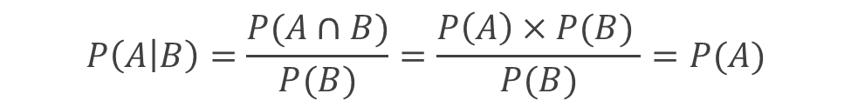
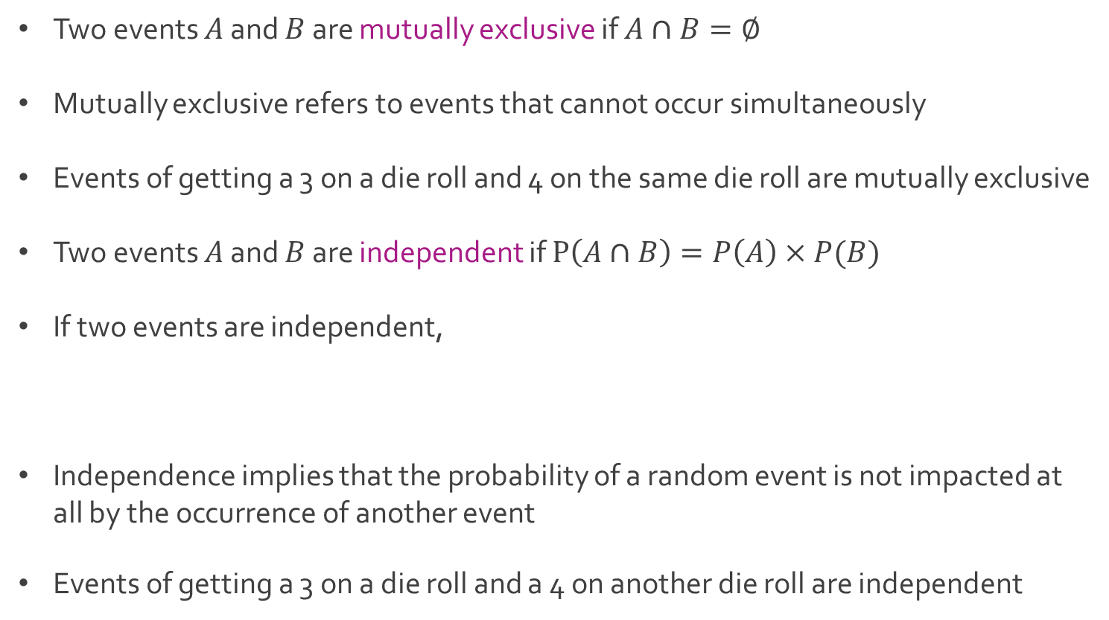
Relationships Between Events
Two events $A$ and $B$ are mutually exclusive if $A∩B=∅$
Mutually exclusive refers to events that cannot occur simultaneously
Events of getting a 3 on a die roll and 4 on the same die roll are mutually exclusive
Two events $A$ and $B$ are independent if $P\left(A∩B\right)=P\left(A\right)×P(B)$
If two events are independent,
Independence implies that the probability of a random event is not impacted at all by the occurrence of another event
Events of getting a 3 on a die roll and a 4 on another die roll are independent
$$P\left(A | B\right)=\frac{P(A∩B)}{P(B)}=\frac{P\left(A\right)×P(B) }{P(B)}=P(A)$$

Slide 10
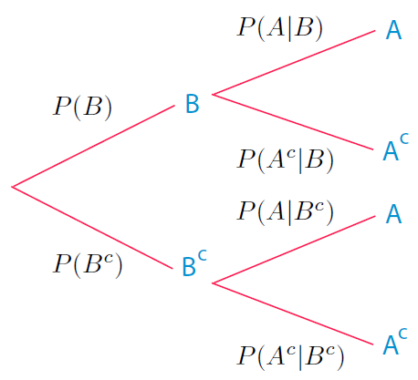
Probability Trees
A probability tree is a diagram used to represent a probability space from a series of experiments (different or repetitive)
Each path leads to a different outcome
Numbers on path indicate probability
Visualization of conditional probability
Multiply probabilities along path to find
the probabilities of different outcomes

Slide 11
Ex: Flippin’ Unfair Coins
A friend of yours has 3 coins in her pocket, two fair coins and one two-headed
The two of you are trying to decide whether to watch “The Greatest Showman” or “Pitch Perfect” tonight
You decide to flip a coin and go see “The Greatest Showman” if it is heads
Your friend takes out one of the coins without looking and flips it
Q: What is the probability that you go see “Pitch Perfect” ?
Q: What is the probability that you go see “The Greatest Showman” ?

Slide 12
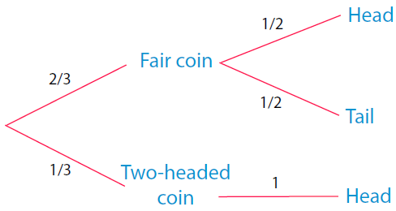
Ex: Flippin’ Unfair Coins
Diagram of this example
Purple indicates the path to watching “Pitch Perfect”
Teal indicates the path to watching “The Greatest Showman”

Slide 13
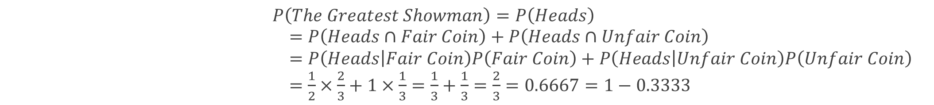
Ex: Flippin’ Unfair Coins
Probability of “Pitch Perfect”
Probability of “The Greatest Showman”
$$P\left(Pitch Perfect\right)=P\left(Tails\right)=P\left(Tails∩Fair Coin\right)$$
$$=P\left(Tails | Fair Coin\right)P\left(Fair Coin\right)=\frac{1}{2}×\frac{2}{3}=\frac{1}{3}=0.3333$$
$P\left(The Greatest Showman\right)=P\left(Heads\right)$
$=P\left(Heads∩Fair Coin\right)+P\left(Heads∩Unfair Coin\right)$
$=P\left(Heads | Fair Coin\right)P\left(Fair Coin\right)+P\left(Heads | Unfair Coin\right)P\left(Unfair Coin\right)$
$=\frac{1}{2}×\frac{2}{3}+1×\frac{1}{3}=\frac{1}{3}+\frac{1}{3}=\frac{2}{3}=0.6667=1−0.3333$

Slide 14
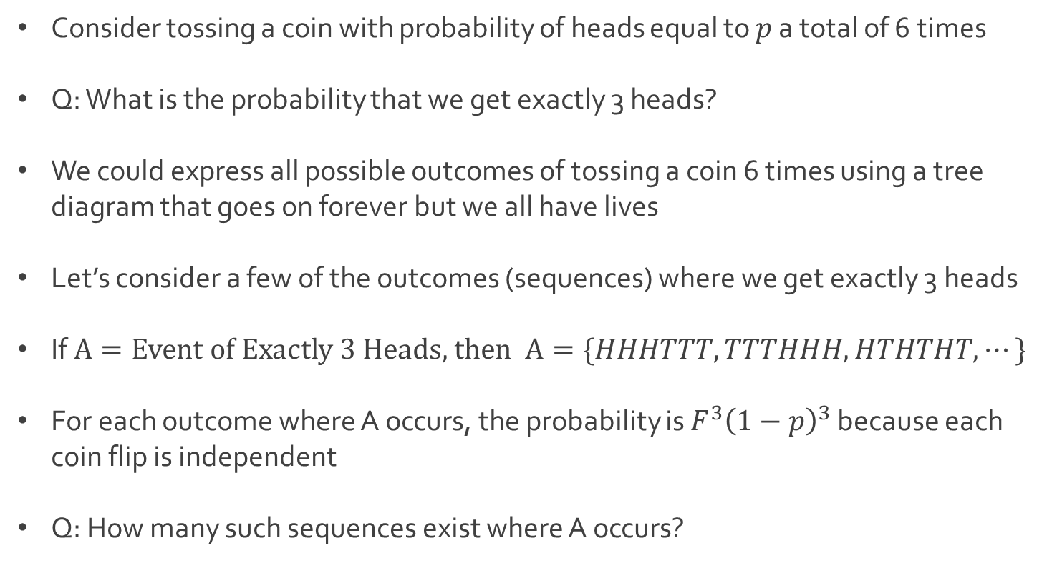
Binomial Probability
Consider tossing a coin with probability of heads equal to $p$ a total of 6 times
Q: What is the probability that we get exactly 3 heads?
We could express all possible outcomes of tossing a coin 6 times using a tree diagram that goes on forever but we all have lives
Let’s consider a few of the outcomes (sequences) where we get exactly 3 heads
If $A=Event of Exactly 3 Heads$, then $A=\{HHHTTT,TTTHHH,HTHTHT, ⋯\}$
For each outcome where A occurs, the probability is $F^{3}{\left(1−p\right)}^{3}$ because each coin flip is independent
Q: How many such sequences exist where A occurs?

Slide 15
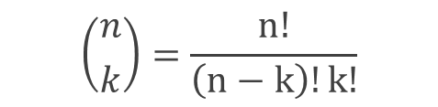
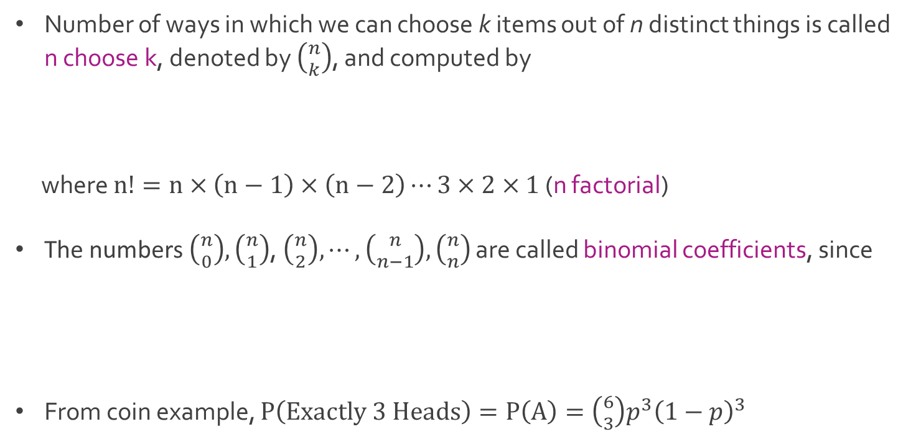

Binomial Probability
Number of ways in which we can choose k items out of n distinct things is called n choose k, denoted by $\left({n \atop k}\right)$, and computed by
where $n!=n×\left(n−1\right)×\left(n−2\right)⋯3×2×1$ (n factorial)
The numbers $\left({n \atop 0}\right),\left({n \atop 1}\right)$, $\left({n \atop 2}\right),⋯,\left({n \atop n−1}\right),\left({n \atop n}\right)$ are called binomial coefficients, since
From coin example, $P\left(Exactly 3 Heads\right)=P\left(A\right)=\left({6 \atop 3}\right)p^{3}{\left(1−p\right)}^{3}$
$$\left({n \atop k}\right)=\frac{n!}{\left(n−k\right)!k!}$$
$${\left(a+b\right)}^{n}=\sum_{k=0}^{n}{\left({n \atop k}\right)a^{k}b^{n−k}}$$

Slide 16

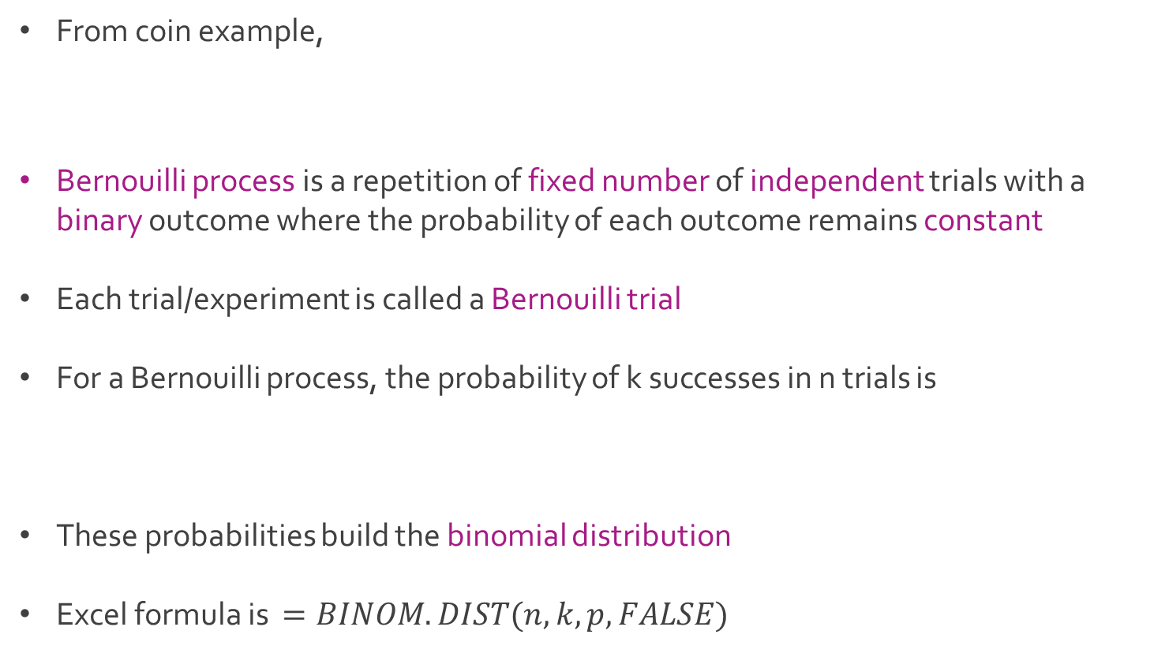
Binomial Probability
From coin example,
Bernouilli process is a repetition of fixed number of independent trials with a binary outcome where the probability of each outcome remains constant
Each trial/experiment is called a Bernouilli trial
For a Bernouilli process, the probability of k successes in n trials is
These probabilities build the binomial distribution
Excel formula is $=BINOM.DIST(n,k,p,FALSE)$
$$P\left(Exactly 3 Heads\right)=P\left(A\right)=\left({6 \atop 3}\right)p^{3}{\left(1−p\right)}^{3}$$
$$\left({n \atop k}\right)p^{n}{\left(1−p\right)}^{n−k}$$

Slide 17




The End
Dale

